Slide 1
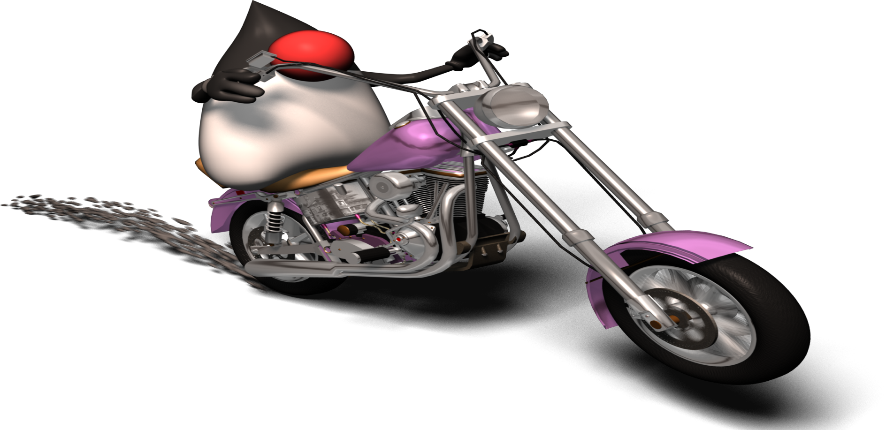
Apache Activiti
An Open Source BPM Platform
Srinivas
05/01/2014

Slide 2
Agenda
Introduction – BPM and WfMC
Various available BPM engines in the market
Activiti Architecture and Terminology
Activiti BPM Engine Components
Activiti modules
POC Demo Examples
Pros and cons of each Implementation

Slide 3
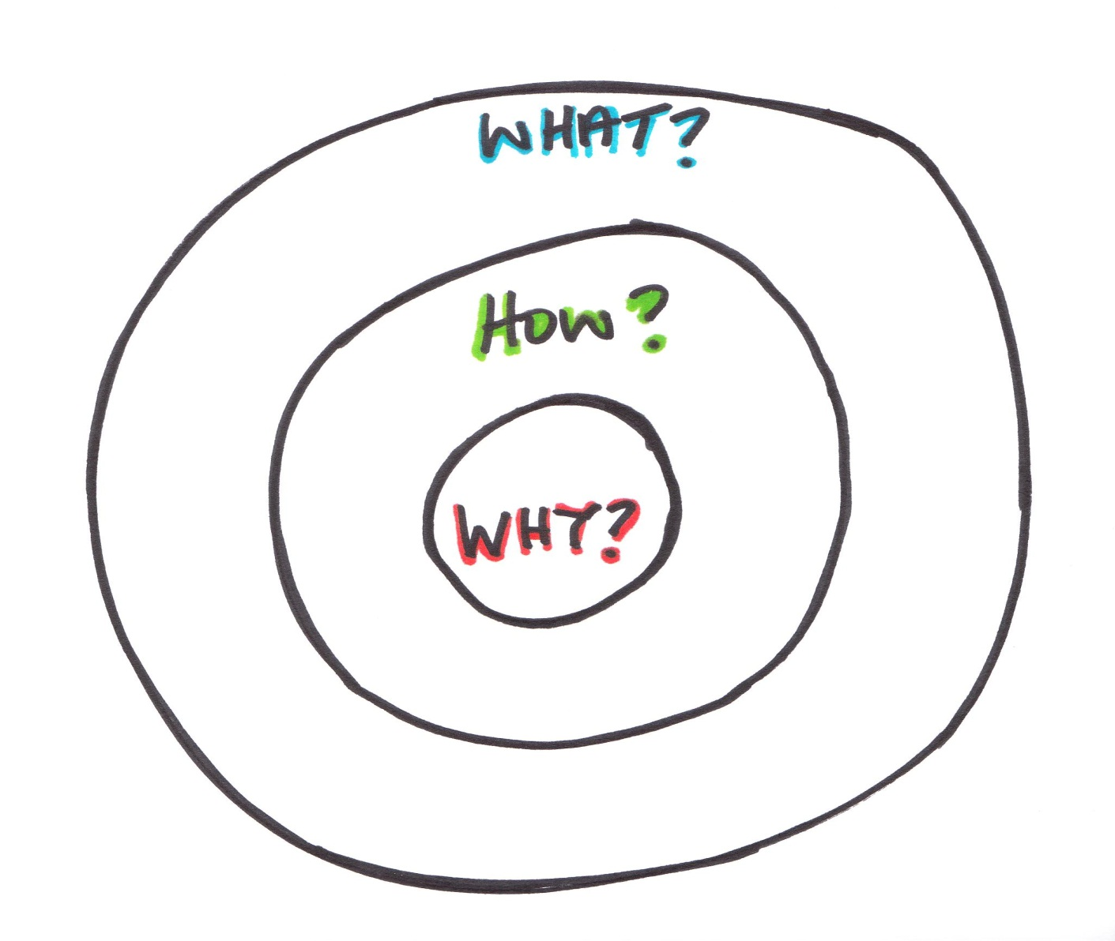
Why ?, How?, and What?

Slide 4
Workflow Management Coalition (WfMC)
WRM Published
BPMN
Work Flow Reference Model - WRM
WPDL – 1st Revision
WPDL and XPDL 1.0
XPDL 2.0
XPDL 2.1 and BPMN 1.1
XPDL 2.2 and BPMN 2.0
New economics
Of Integration
1993 1995 1998 2002 2004 2005 2008 2012

Slide 5
Various Open-Source BPM Engines
Activiti
jBPM
Enhydra Shark
OpenSymphony OSWorkflow
con:cern
Werkflow
ObjectWeb Bonita
Bossa
Open Business Engine
The Open for Business Workflow Engine
OpenWFE
WfMOpen
XFlow
JFolder
Taverna

Slide 6
Various Open-Source BPM Engines
Freefluo
Micro-Flow
JFlower
YAWL
kbee.workflow
Syrup
PXE
ActiveBPEL
Zebra
Apache Agila
Antflow
Beexee
Dalma
Swish
BpmScript
jawflow
RUNA WFE
Imixs IX Workflow

Slide 7
Various BPM Engines
Pegasus
Wilos
Apache ODE
Tobflow
Bonita Open Solution
Joget Workflow
Lombardi (IBM)
TIBCO
MQ Workflow (IBM)
iCAN (Seebeyond)
Oracle Fusion
Biztalk (.Net)
Enhydra Shark

Slide 8

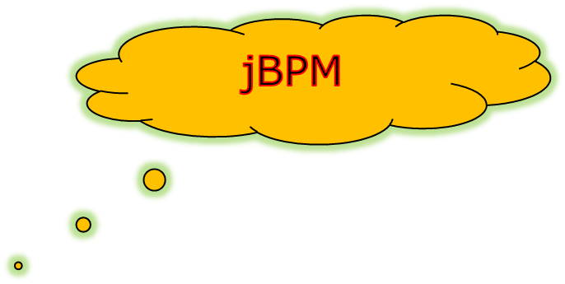

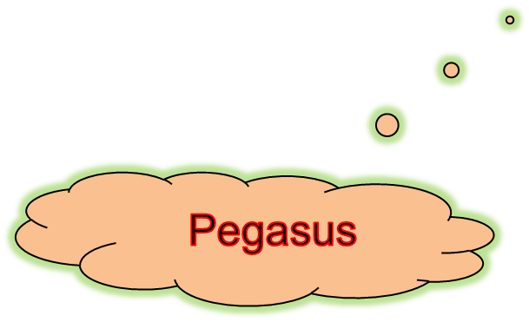
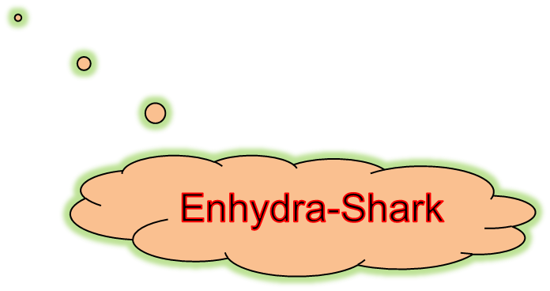
Popular BPM Engines (Open-Source)

Slide 9
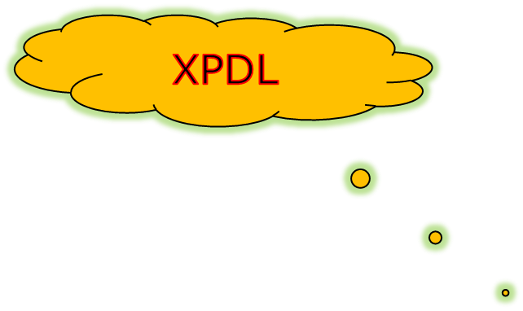
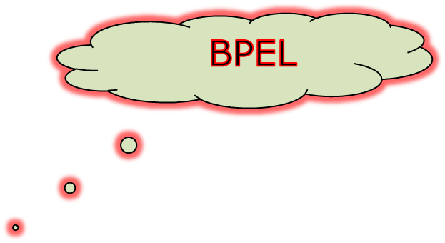




Various Modelling Languages
Shark
Activiti
jBPM

Slide 10

Activiti Overview - History

Slide 11
Activiti Modules – 5.14
Activiti Designer
Activiti Explorer
Activiti REST

Slide 12
Activiti Overview
Activiti Designer
Used for modelling the business process
Core BPM Engine
Process Implementation
WS
Activiti Engine
DB
<definitions>
<process>
<startEvent/>
<sequenceFlow/>
<endEvent/>
</process>
</definitions>
Tasks
Jobs
REST
Processes
Web Forms
BPMN-2.0

Slide 13
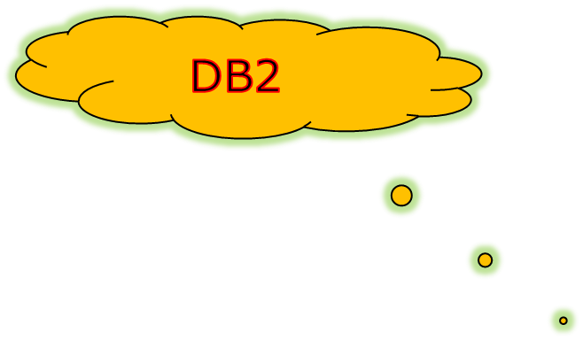
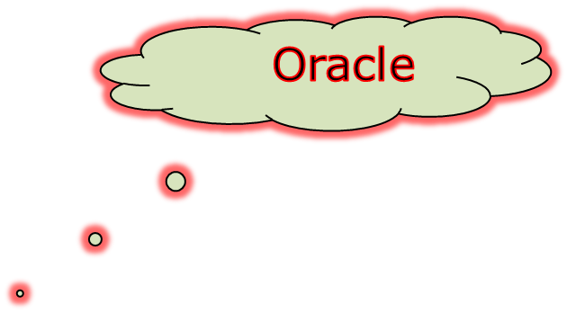
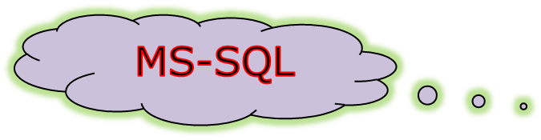



Activiti Supported Databases

Slide 14
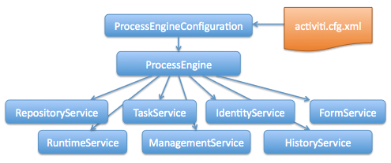
Activiti Engine Services

Slide 15
Activiti POC Demo

Slide 16
Pros and Cons of Activiti BPM Engine
Standards based – Based on BPMN-2.0 standard
Open source and No licensing
Tight integration with Spring
Easy to integrate the existing spring beans into your business process
Easy to embed the existing web services inside your business process
Slim and easy to use, suitable for small to mid size projects

Slide 17
Pros and Cons of Activiti BPM Engine
Can be used as a standalone work flow engine
Can be used as a service
Easy to embed into your existing web application
Provides eclipse plugins for business process modelling
Administration console – Provides, but not superior
Provides Drools integration

Slide 18
Pros and Cons of Activiti BPM Engine
Supports both XML and Annotation based approaches.
Provides support for multiple databases
Support for external UI - Limited
One more acronym to add your resume. Somebody will hire you.

Slide 19
Pros and Cons of Activiti BPM Engine
Lack of documentation and tutorials
Debugging is a challenge
Ajax and Rich UI implementation is a challenge.
Limited UI capabilities

Slide 20

Comparison
Lombardi (7.2) vs. Activiti vs. JBPM vs. Shark

Slide 21
Main differences between
Activiti and jBPM
 | Activiti | jBPM
Community members | Alfresco. Also from Spring Source and Mule Soft | JBOSS
Spring support | Has native spring support | No native Spring support.
Business rules support | Provides basic integration with Drools rule engine | jBPM and Drools are integrated on a project level
Additional tools | Modeler, Explorer, and REST based service interfaces | Eclipse designer
Release schedules | Every 2 months | Some releases have been postponed

Slide 22
Recommendation
&
Savings

Slide 23
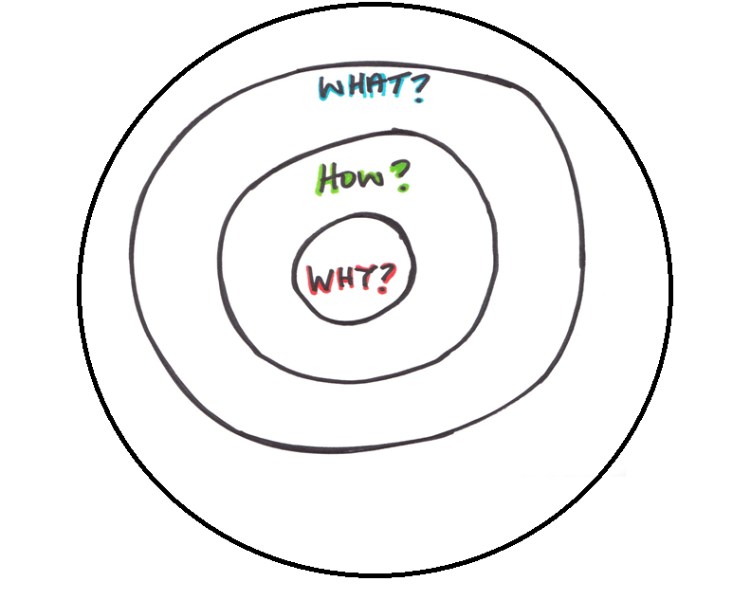
Who ??
Who ?
WHO can I blame when it all goes wrong?

Slide 24

Summary
Open Source
Supports multiple DB’s
BPMN-2.0
Forms support
Supports various Tasks
Eclipse based Designer tool
REST service API for remote access
Standalone BPM engine
Rule Task - Drools
Supports Spring integration

Slide 25

Activiti BPM Engine
POC Demos

Slide 26
References
http://activiti.org/
http://java-source.net/open-source/workflow-engines
http://www.mastertheboss.com/activiti-bpmn/jbpm-vs-activiti-which-to-choose
http://en.wikipedia.org/wiki/XML_Process_Definition_Language

Slide 27


